Slide 1
Engineering the Personal Social Semantic Web
Fabian Abel & Geert-Jan Houben
Notes:
Where to put “Evaluation of UMAP systems”? Should we integrate it into the first chapter “Introduction: UMAP”?

Slide 2
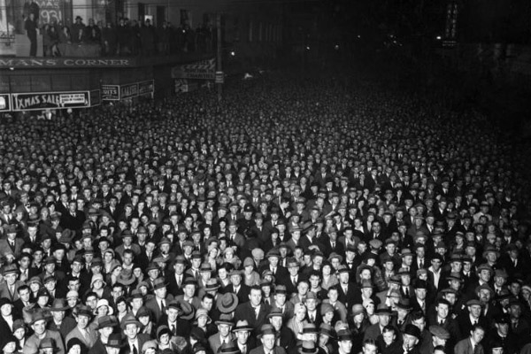
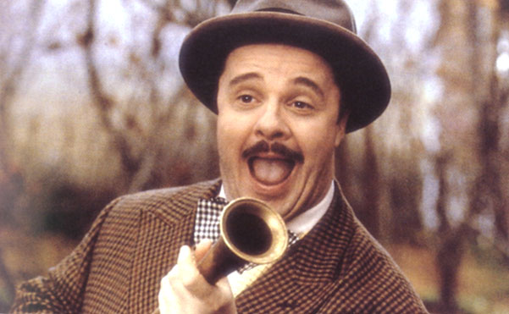
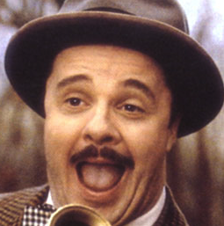
The Social Web
Who is this? What are his
personal demands? How
can we make him happy?
Give me news that are now of interest for me! ;-)
Recommend me some Web sites that help me now!
Name: John van Bommel
Age: 49
Hometwon: London
Hobbies: rowing, music
Listened to Jamie Cullum
Listened to Nils Wuelker
Help me to tackle the information overload on the Web!
I like this http://bit.ly/4Gfd2
I agree with @bluebird23. This is an #epicfail?

Slide 3
Social Web → Personal Web
Social Web
we need to know the person
music profile
friends profile
location profile
before we adapt to the person
Personal Web

Slide 4
Motivation
To make the Personal Web, to make the Social Web, as engineers of applications we need to know the people.
To know the people has been the driving challenge in the research field of User Modeling, Adaptation and Personalization, in short UMAP.
We start with an overview of UMAP and its basic concepts.

Slide 5
Overview
Introduction: UMAP
User Modeling
Adaptation
Personalization
Evaluation of UMAP Systems
UMAP in Social Web Systems
UMAP in Social Tagging Systems
UMAP across Social Web systems
Engineering UMAP on the Social Semantic Web
Towards the Personal Web
Exploiting Microblogging Activities for Personalizing the Social Web

Slide 6
1. Introduction: UMAP

Slide 7
The user matters
When we consider state of the art interaction & interfaces, then the user plays a key role.
For good personalized application and interface design, a good characterization of the user is needed.
First, some basic user modeling concepts from theory and literature.

Slide 8
User profile
Definition: A user profile is a data structure that represents a characterization of a user at a particular moment of time.
So, a user profile represents what, from a given (system) perspective, there is to know about a user.
The data in a user profile can be explicitly given by the user or have been derived by the system.

Slide 9
User characteristics
Personal data
Friend and relations
Experience
System access
Browsing history
Knowledge (learning)
Device data
Location data
Preferences

Slide 10
User characteristics
Knowledge, beliefs and background (e.g. AEHS)
Interests and preferences (e.g. Web)
Goals, plans, tasks and needs (e.g. intelligent dialogues)
Demographic information (e.g. e-commerce)
Emotional state (e.g. affective computing)
Context (e.g. pervasive, ubiquitous settings)

Slide 11
User model
Definition: The user model contains the definitions and rules for the interpretation of observations about the user and about the translation of that interpretation into the characteristics in a user profile.
So, a user model is the recipe for obtaining and interpreting user profiles.
N.B. Sometimes the term user model is used where user profile is meant.

Slide 12
User modeling
Definition: User modeling is the process of creating user profiles following the definitions and rules of the user model. This includes the derivation of new user profile characteristics from observations about the user and the old user profile, based on the user model.
So, user modeling is the process of representing the user.
Conference series: first UM, now UMAP
Journal: UMUAI

Slide 13
User model aspects
A user model contains:
representations of what the user has explicitly provided, and/or
assumptions by the system about the user.
Data in such a user model can be in attribute-value pairs, probabilities, fuzzy intervals, rules, references, etc.
Data in user models can concern short-term or long-term.

Slide 14
User modeling approaches
In UMAP literature as well as in practice, we have seen many different approaches to user modeling.
UMAP research has been aimed at investigating which approach suits best the conditions of a given application.

Slide 15
Stereotyping
Stereotyping is one example of user modeling.
A user is considered to be part of a group of similar people, the stereotype.
Question: What could be stereotypes for conference participants (when we design the conference website)?

Slide 16
Overlay UM
Overlay models are among the oldest and have often been used for modeling student knowledge.
In an overlay model, the user is characterized in terms of domain concepts, typically given by experts, and hypotheses regarding the user’s knowledge about these concepts.
Often, this leads to the use of concept-value pairs.
Question: Can you give examples for overlay modeling?

Slide 17
Customizing
With customizing a user explicitly provides some elements of a user profile herself, e.g. through a form.
Thus, the system can exploit a user profile that the user can configure, tune, and change herself.
Examples: personal data, preferences.

Slide 18
User model elicitation
Ask the user explicitly (and learn).
NLP, intelligent dialogues.
Bayesian networks, Hidden Markov models, etc.
Observe the user (and learn).
Logs, machine learning.
Clustering, classification, data mining, etc.
Interactive user modeling.
The user does it herself.
Scrutability.

Slide 19
Adaptation

Slide 20
Adaptation
Knowing the user, this knowledge can be applied to adapt a system or interface to the user.
Adaptation, or user-adaptation, concerns the exploitation of the knowledge about users to improve the functionality and experience (of a system or interface).

Slide 21
User-adaptive system
Definition: A user-adaptive system is a system that adapts itself to a specific user.
Often, a user-adaptive system (or adaptive system, in short) uses user profiles to base its adaptation on.
So, designing an adaptive system implies designing the user modeling. This includes deciding on the observations considered, the modeling choices, and the profiles to be used.

Slide 22
User-adaptation
User-adaptation is often used for personalization, i.e. making a system appear to function in a personalized way.
Question: What user profile characteristics would be useful in personalizing the conference’s registration site?
Question: How would you obtain those characteristics?

Slide 23
Examples: User-adaptation
Device-dependence
Accessibility (disabilities)
Location-dependence
Adaptive workflow
Question: Can you give concrete examples for interface adaptation, both the adaptation effect as the prior user modeling necessary?

Slide 24
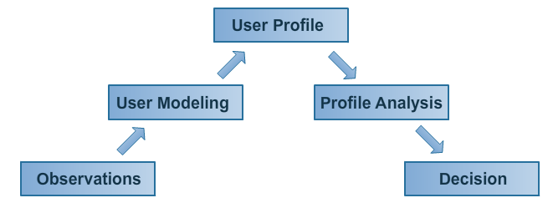
User-adaptive systems
A. Jameson. Adaptive interfaces and agents. The HCI handbook: fundamentals, evolving technologies and emerging applications, pages 305–330, 2003.

Slide 25
UM as basis for personalization
jazz
profile
?
profile
user modeling
play
click
user modeling
holiday
profile
user modeling
friends
profile
tech
profile

Slide 26
Adaptive hypermedia
A well-studied example of adaptation is adaptive hypermedia.
In adaptive hypermedia a hypertext’s content and navigation can be adapted to the user’s browsing of the hypertext:
Content adaptation is about changing the content.
Navigation adaptation is about changing the navigation structure.

Slide 27
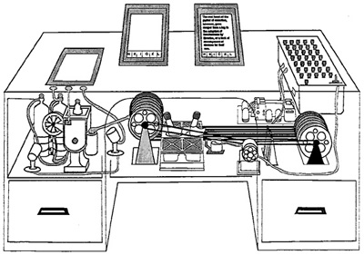
Hypertext
One starting point in research
It started with hypertext, from Vanevar Bush’s Memex (memory extension) and Doug Engelbart (augmenting human intellect) …

Slide 28
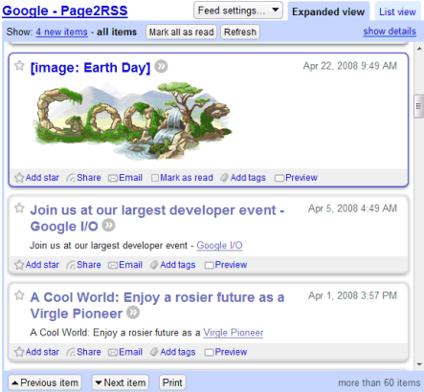
Hypertext
One starting point in research
… towards navigation-oriented structures of pages and hyperlinks. A lot of research on rich navigation and exploration facilities.
Home
Home
document
anchor
link

Slide 29
Adaptive hypermedia
Augmenting hypertext with adaptation
Later hypertext systems were augmented with adaptation, user-adaptation, making the pages and hyperlinks adaptive to the user.
“static”: adapting to user preferences, determined beforehand,
for example, for the device or language the user uses or prefers.
“dynamic”: adapting to user behavior, while using the system,
for example, for acknowledging the acquisition of knowledge by going through the content.
Applications: education, e-commerce, manuals, individual views or presentations, etc.
Conference series: first AH, now UMAP after merge with UM

Slide 30
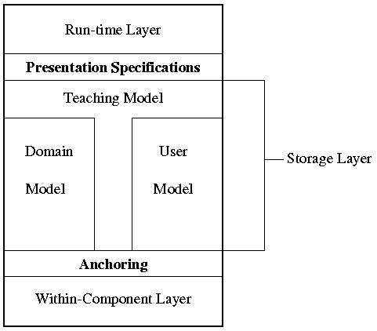
Adaptive hypermedia
Augmenting hypertext with adaptation
AHAM Reference model
Based on Dexter.

Slide 31
Adaptive hypermedia
Augmenting hypertext with adaptation
AHAM Reference model
Based on Dexter.
(De Bra et al. 1999)
Adaptation Model
Data / Domain Model
User/ Context
Model

Slide 32
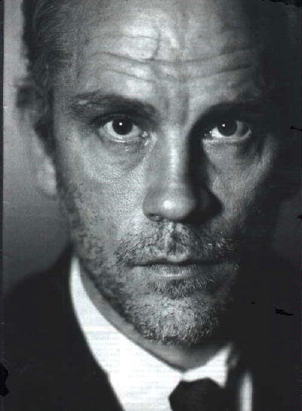
Adaptation Model
Data / Domain Model
User/ Context
Model
Contact Data
------------------------
Name: John
Street: 29 Heddon Str, City: London
Picture:
If on phone
show only text

Slide 33
Adaptation Model
Data / Domain Model
User/ Context
Model
Contact Data
------------------------
Name: John
Street: 29 Heddon Str City: London
Picture:
If on phone
show only text
Contact Data
------------------------
Name: John
Street: 29 Heddon Str
City: London

Slide 34
Adaptive hypermedia
Methods and techniques (Brusilovsky 2001)
Adaptive navigation support
Direct guidance
Adaptive link sorting
Adaptive link hiding (hiding, disabling, removal)
Adaptive link annotation
Adaptive link generation
Map generation
Adaptive presentation
Adaptive multimedia presentation
Adaptive text presentation (natural language adaptation, canned text (fragment) adaptation)
Adaptation of modality

Slide 35
Adaptive hypermedia
Tools and systems
Many systems being investigated in research and in use.
Examples: InterBook, AHA!
(UMAP conference series on user modeling, adaptation and personalization)
Perspective on systems:
Rich in functionality
Like original hypertext systems (richer than basic Web apps)
Often closed
Impossible to interface and re-use. Not Open Corpus.
Require effort and investment
Learning curve, in software and content/context modeling.
Fit for certain domains
For example, Adaptive Educational Hypermedia Systems (AEHS).

Slide 36
Lost in hyperspace problem
The problem of being lost in hyperspace refers to a state of disorientation, where a user is confused about her position in a hyperspace navigation structure.
In adaptive hypermedia, the links and the nodes (the navigation and the content) change quickly and significantly, and therefore the lost in hyperspace problem can occur more.
In the design of adaptive hypermedia this design challenge needs to be considered.
Note that sometimes a feeling of being in different places can be created on purpose.
Serendipity makes users be alert to new situations.

Slide 37
Personalization

Slide 38
Personalization
With personalization the user-adaptation is really geared towards the individual, the person.
Examples that use personalization are systems that provide recommendations or personalized search.

Slide 39
Recommender systems
There are two basic classes of recommender systems.
Collaborative filtering.
Content-based recommenders.

Slide 40
Collaborative filtering
Input:
user preferences for items. For example:
explicit ratings
implicit observations such as click data
Approach for recommending items to a user u1:
recommend items to u1 that are liked by users who are similar to u1
similar users = users that like similar items
→ word of mouth
u1
likes
likes
likes
→ u1 likes Pulp Fiction?
u2

Slide 41
Collaborative filtering methods
Memory-based:
Via User-Item matrix:
matrix stores ratings/preferences of users regarding items
compute similarity between users and recommend items of similar users
Model-based:
Via Item-Item matrix:
matrix stores similarity (e.g. based on user ratings) between items
recommend items that are similar to the ones the user already likes
Based on clustering:
cluster users according to their preferences
recommend items of users that belong to the same cluster
Bayesian networks, for example:
P(u likes item B | u likes item A) = how likely is it that a user, who likes item A, will like item B → learn probabilities from user ratings/preferences
Others: rule-based, other data mining techniques
Badrul Sarwar, George Karypis, Joseph Konstan, and John Riedl: Item-based Collaborative Filtering Recommendation Algorithms. WWW 2010 http://www.grouplens.org/papers/pdf/www10_sarwar.pdf

Slide 42
Collaborative filtering via User-Item matrix
Which item should we recommend Adam?
User-Item matrix:
User \ Item | The Godfather | Pulp Fiction | Avatar | Toy Story
Adam | 5 |  | 1
Bob |  | 1 | 4 | 4
Mary | 5 | 4 | 1 | 1
Similarity between Adam and the other users (e.g. via cosine similarity):
sim_{cosine}(Adam, Bob) = 0.14
sim_{cosine}(Adam, Mary) = 0.78
Recommend item that Mary likes most (and that has not been rated yet by Adam):
recommendation = Pulp Fiction

Slide 43
Content-based
Idea:
Input:
characteristics of items
interests of a user into characteristics of items
Recommend items that feature characteristics which meet the interests of a user
Techniques:
Data mining methods, for example:
Cluster items based on their characteristics
Infer users’ interests into clusters
Information retrieval methods, for example:
Represent items and users as term vectors
Compute similarity between user profile vector and items
Utility-based methods:
Utility function that gets an item as input
Parameters of the utility function are customized via preferences of a user

Slide 44
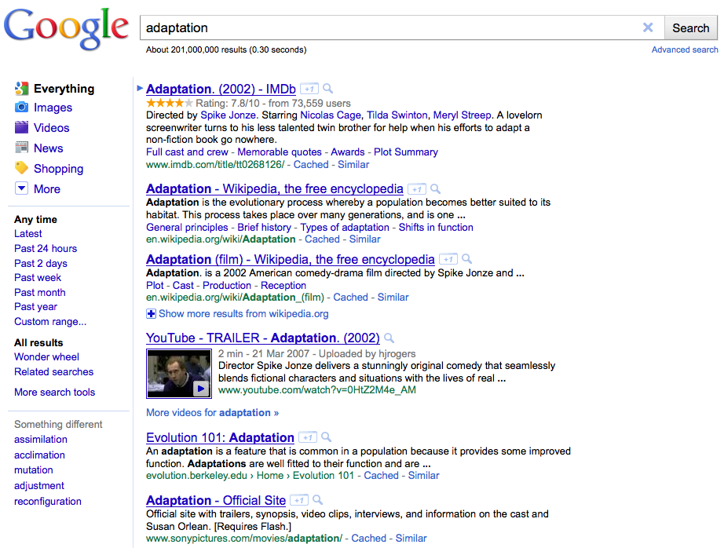
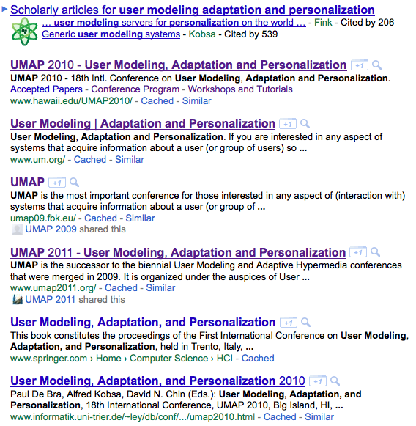
Personalized Search
Personalize search result rankings according to personal preferences and current demands of a user.
Bob searches for “adaptation”…
not relevant for Bob
(at least not now)
Bob might now rather be interested in computer science research on adaptation.

Slide 45
Evaluation of UMAP systems

Slide 46
What is good user modeling and personalization?
From the consumer perspective of an UMAP system:
From the provider perspective of an UMAP system:
UMAP system maximizes satisfaction of the user
hard to measure/obtain
influence of UM &
personalization may be
hard to measure/obtain
UMAP system maximizes
the profit

Slide 47
Good user modeling?
Depends on the application and domain:
User Modeling
type of
application:
Personalized
Recommendations
Personalized Search
Adaptive Systems
domains: news social media cultural heritage public data e-learning…

Slide 48
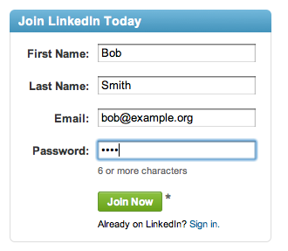
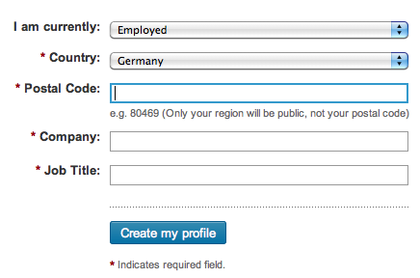
Example: User Modeling for supporting users in filling forms
User Modeling
Required profile
information:
first name
last name
address
current company
…
Completing profile information

Slide 49
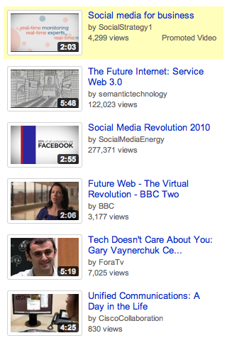
Example: User Modeling for movie recommendations
Recommendations:
User Modeling
Required profile
information:
preferences in videos
language
cultural background
…
movie recommendations

Slide 50
Short Overview on evaluation strategies
User studies:
Clean-room study: ask/observe (selected) people whether you did a good job
Log analysis:
Analyze (click) data and infer whether you did a good job
For example: cross-validation such as Leave-one-out
Evaluation of user modeling:
measure quality of profiles directly, for example:
measure overlap with existing (true) profiles
let people judge the quality of the generated user profiles
measure quality of application that exploits the user profile, for example:
apply user modeling strategies in a recommender system

Slide 51
Example: Evaluating User Modeling Strategies in a recommender system
training data
test data (ground truth)
item C
item G
item A
item H
item E
item B
item D
measure
quality
item F
time
training data
Recommendations:
Strategy X
X
Y
Z
?
Strategy Y
Recommender
item R
item H
item F
Strategy Z
item H
item G
item H
?
?
?
User Modeling strategies to compare
item M
item N
item M

Slide 52
Metrics
Usual suspects from IR:
Precision: fraction of retrieved items that are relevant
Recall: fraction of relevant items that have been retrieved
F-Measure: (harmonic) mean of precision and recall
Useful metrics for evaluating recommendation (rankings):
Mean Reciprocal Rank (MRR) of first relevant item:
Success@k: probability that a relevant item occurs within the top k
If a true ranking is given: rank correlations (e.g. Kendall tau)
Precision@k, Recall@k & F-Measure@k
Useful metrics for evaluating prediction of user preferences:
MAE = Mean Absolute Error
True/False Positives/Negatives
further reading
rank of first relevant item
in recommendation ranking i
R = recommendation runs

Slide 53
When are your results good?
Always compare with some baseline
Do significant tests
For example: t-tests
performance
Null Hypothesis H₀:
performance of strategy X = performance of baseline
Alternative H₁:
performance of strategy X > performance of baseline
T-test computes p-value:
probability that the statistical test result is – under the given null hypothesis – at least as extreme as the one that was observed.
We can reject H₀ if p-value < α (= significance level)
strategy X
baseline
runs
Is strategy X better than the baseline?

Slide 54
2. UMAP in Social Web Systems

Slide 55
Social Web

Slide 56
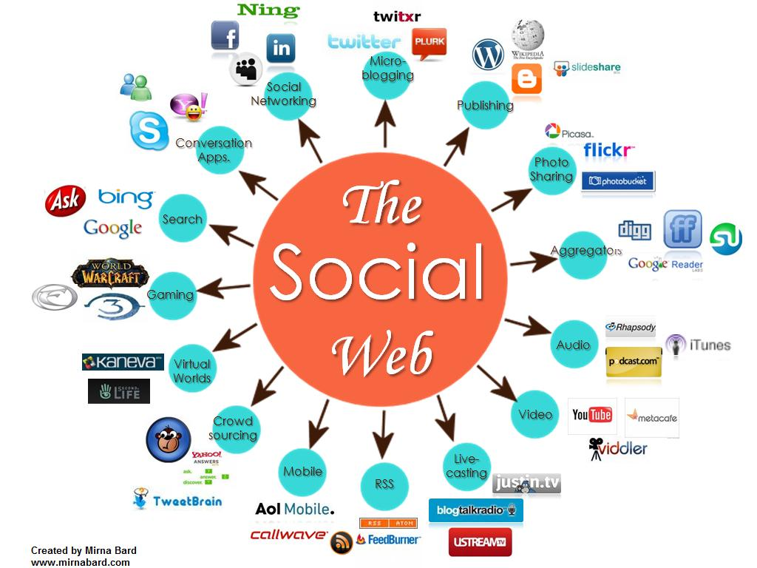
Social Web
The term “Social Web” describes a paradigm of social participation on the Web: the Web is made by people.

Slide 57
Power-Law of Participation by Ross Mayfield 2006

Slide 58
UMAP in Social Tagging Systems

Slide 59
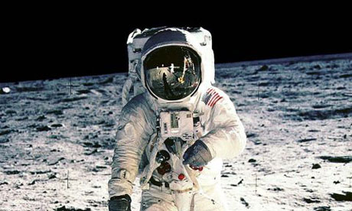
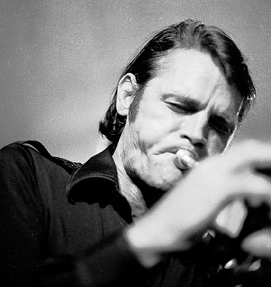
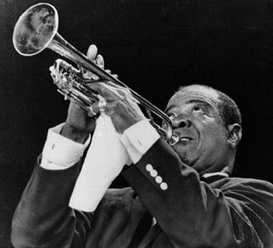
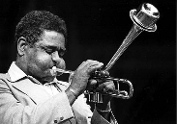
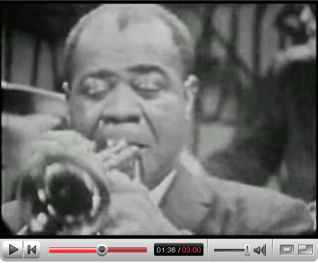
Social Tagging
jazzmusic
armstrong
trumpet
baker, trumpet
trumpet
dizzy, jazz
armstrong
Structures that evolve when people annotate Web resources with freely chosen keywords are called folksonomies.

Slide 60
Modeling Tagging Activities

Slide 61
Folksonomies
tag
user
resource
Folksonomy:
set of tag assignments
formal model by Hotho et al. (2006):
F = (U, T, R, Y)
tag assignment
y1:
jazzmusic
u1
r1
y2:
trumpet
jazzmusic
u1
r3
trumpet
armstrong
y3:
trumpet
moon
u2
r3
users
tags
resources
tag assignments
A. Hotho, R. Jäschke, C. Schmitz, and G. Stumme. Information retrieval in folksonomies: Search and ranking. In Proc. ESWC, volume 4011 of LNCS, pages 411–426, Budva, Montenegro, 2006. Springer.

Slide 62
Context in Folksonomies
music
jazz
Jazz (noun) is a
style of music that…
Resource Y
created: 1979-12-06
creator: …
context
context
context
User X
Age: 30 years
Education: …
context
tag
user
resource
jazz
tag assignment
User X
TAS XY
created: 2011-04-19
meaning: dbpedia:Jazz
Context folksonomy:
F_{c} = (U, T, R, Y, C, Z)
C is the actual context information
Z Y x C is the set of context assignments

Slide 63
Structure of Folksonomies
The structure of a folksonomy is influenced by the design of the tagging system
Tagging Design dimensions (see Marlow et al, 2006)
Tagging support: are tags, which are already assigned to a resource, visible? Do users get tag recommendations?
Tagging rights: who is allowed to tag (e.g. friends, free-for-all, owner of the resource)
Aggregation model: can the same tag be assigned to the same resource more than once?
→ broad vs. narrow folksonomies (Vander Wal, 2005)
How would you design a tagging system so that the “tag vocabulary” aligns as quickly as possible?
C. Marlow, M. Naaman, D. Boyd, and M. Davis. HT06, tagging paper, taxonomy, flickr, academic article, to read. In Proc. of the 17th Conf. on Hypertext and Hypermedia, pages 31–40. ACM Press, 2006.
T. Vander Wal. Explaining and showing broad and narrow folksonomies.
http://www.vanderwal.net/random/entrysel.php?blog=1635
How would you design a tagging system so that users are best supported in organizing and re-finding resources?

Slide 64
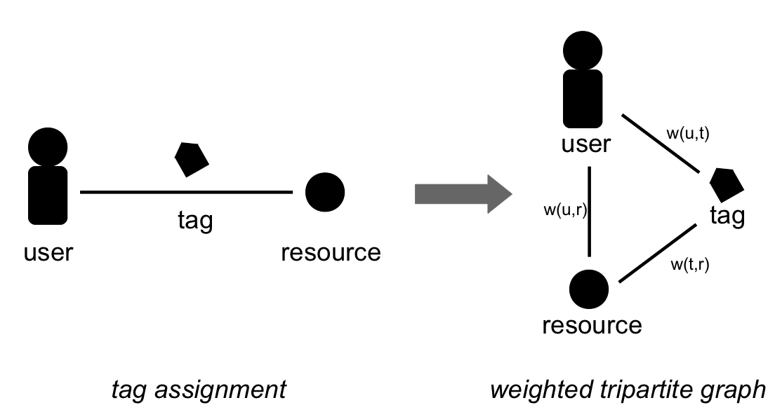
Folksonomy Graph
A folksonomy (tag assignments) can be represented via an undirected weighted tripartite graph G_{F} = (V_{F}, E_{F}) where:
V_{F} = U U T U R is the set of nodes
E_{F} = {(u,t), (t,r), (u,r) | (u,t,r) in Y} is the set of edges

Slide 65
How to weigh the edges of a folksonomy graph?
w(u1, r1)
w(t1, r1) = ?
w(t1, r1) = 2
w(t1, r1)
w(u,t) = ?
w(u,r) = ?
w(t,r) = ?
u1
w(u1, t1)
w(u2, t1)
t1
r1
w(u2, r1)
w(u1, t1) = ?
w(u1, t1) = 1
w(t2, r2)
w(u2, t2)
t2
w(u2, t1) = ?
u2
w(u2, r2)
r2
w(u2, t1) = 1
For example:
w(t,r) = {u in U| (u, t, r) in Y} = count the number of users who assigned tag t to resource r

Slide 66
Personomies
A personomy is a restriction of a folksonomy F to a specific user:
P_{u} = (T_{u},R_{u},Y_{u})
where:
Y_{u} are all tag assignments performed by user u
T_{u} and R_{u} are all tags and resources that are referenced from tag assignments in Y_{u}

Slide 67
Tag-based (User) Profile
A tag-based user profile is a set of weighted tags where the weight of a tag t is computed by a certain strategy w with respect to a given user u:
Weighting function:
Lighweight approach counts the number of tag assignments in the user’s personomy P_{u} that refer to t: w(u,t) = |{r in R: (u,t,r) in Y}|
More advanced strategies consider further contextual information (e.g. time, cf. Michlmayr and Cayzer 2007)
Normalizing the weights in a profile is useful
(e.g. 1-norm → sum of weights in a profile equals 1)
E. Michlmayr, S. Cayzer, and P. Shabajee. Add-A-Tag: Learning Adaptive User Profiles from Bookmark Collections. In Proc. of the 1st Int. Conf. on Weblogs and Social Media (ICWSM), 2007

Slide 68
Other types of tag-based profiles
Tag-based profile of a folksonomy entity e:
Examples:
Tag-based profile of a resource
(tag cloud of a resource)
Tag-based context profile
(e.g. tag cloud that represents a certain time interval)
Aggregation of Profiles:
Accumulation of tag-based profiles
For example: tag-based profile of a group of resources/users
folksonomy entity
contextual information
context
context
context
context
tag
user
resource
tag assignment

Slide 69
Exploiting Tag-based Models

Slide 70
Ranking in Social Tagging Systems
Ranking algorithms can be applied in various contexts such as:
(Personalized) Search
Expert Search
Recommender Systems (e.g. tag recommendations)
Learning Semantics
Challenge: order folksonomy entities (= users, tags, resources) so that the most relevant items appear at the very top of the ranking.
depends on the application context

Slide 71
FolkRank (Hotho et al. 2006)
FolkRank is an application of PageRank [Page et al. 98] for folksonomies:
FolkRank vector
preference
vector
adjacency matrix models the folksonomy graph
influence of preferences
u1 u2 t1 t2 r1 r2
FolkRank-based rankings:
users tags resources
1.
2.
u1
u2
t1
t2
r1
r2
0
0
1
0
0
0
u1
u2
t1
t2
r1
r2
u1 0.5 0.5
u2 0.25 0.25 0.25 0.25
t1 0.25 0.25 0.5
t2 0.5 0.5
r1 0.25 0.25 0.5
r2 0.5 0.5
0.1
0.2
0.3
0.1
0.3
0.1
u1
u1
t1
r1
t1
r1
t1
u2
r1
t2
u2
r2
How would you exploit contextual information of tag assignments with FolkRank?
For example, assume that there exist for each tag a URI that specifies the semantic meaning of the tag assignment: (user, tag, resource, URI)
r2
t2
u1
A. Hotho, R. Jäschke, C. Schmitz, and G. Stumme. Information retrieval in folksonomies: Search and ranking. In Proc. ESWC, volume 4011 of LNCS, pages 411–426, Budva, Montenegro, 2006. Springer.

Slide 72
SocialHITS (Abel et al. 2010)
Roles of nodes in a Web graph:
authorities hubs
HITS (Kleinberg 1999)
authority score:
hub score:
In Social Tagging Systems:
nodes = user, tags, resources; edges: undirected
application mentioned by Wu et al. (2006)
SocialHITS exploits context (timestamps):
idea: “hub users imitate authority users”
for example:
- by tagging the same resource
- by using the same tag
2011-04-01
u1
t1
u2
t2
2011-04-20

Slide 73
Other Folksonomy-based ranking algorithms
SocialPageRank (Bao et al. 2006):
Application of PageRank
Difference to FolkRank: “random walk” is restricted
GRank and GFolkRank:
FolkRank based ranking strategies that exploit contextual information
SocialSimRank (Bao et al. 2006)
Based on SimRank (Jeh and Widom 2001)
Core idea: two entities are similar if they point to similar (other) entities
TFxIDF-based ranking
S. Bao, G. Xue, X. Wu, Y. Yu, B. Fei, and Z. Su. Optimizing Web Search using Social Annotations. In Proc. of 16th Int. World Wide Web Conference (WWW ’07), pages 501–510. ACM Press, 2007.
F. Abel, N. Henze, D. Krause, and M. Kriesell. On the effect of group structures on ranking strategies in folksonomies. In R. Baeza-Yates and I. King, editors, Weaving Services and People on the World Wide Web, pages 275–300. Springer, July 2009.
G. Jeh and J. Widom. SimRank: A Measure of Structural-Context Similarity. In Proceedings of KDD ’02, pages 538–543, New York, NY, USA, 2002. ACM.

Slide 74
Personalized Search in Social Tagging Systems

Slide 75
Search via Tags in Flickr
Flickr.com screenshot
user eelcoherder clicks on “conference”

Slide 76
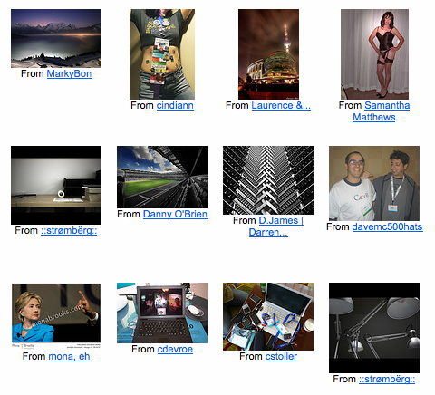
Search via tags in Flickr
Flickr.com screenshot
Problems:
ranking is just based on the tag “conference”
too many pictures tagged with “conference”
user and his context is not taken into account

Slide 77
How can we personalize and contextualize search in social tagging systems?
user & context
query
ranking algorithms
results
tag₁
t₁
tag₂
u₉
tag₃
tag₂
t₇
u₃
user clicks
on a tag
Folkrank
SocialHITS
...
t₅
u₆
t₃
u₁
user navigates through
the content of a tagging
system
results should be relevant
to both the query and
the user’s context

Slide 78
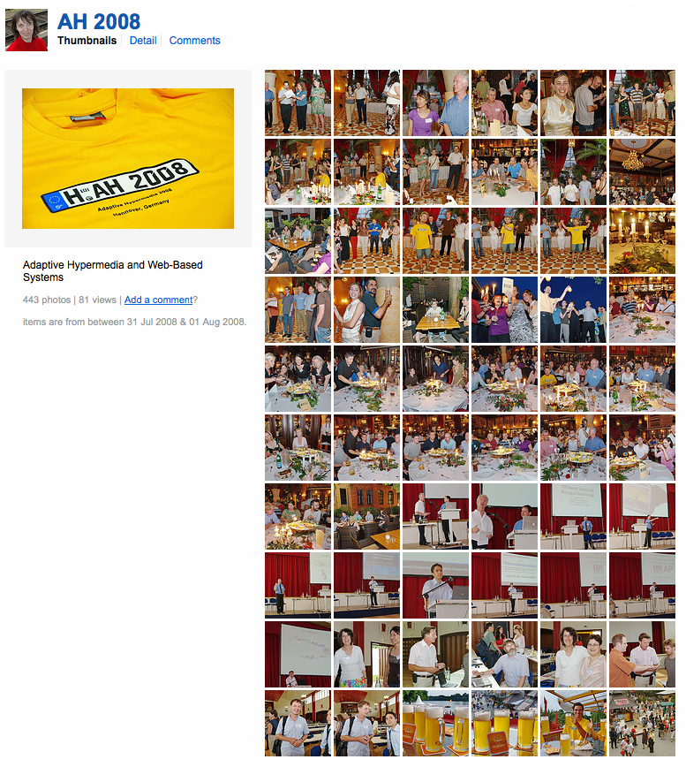
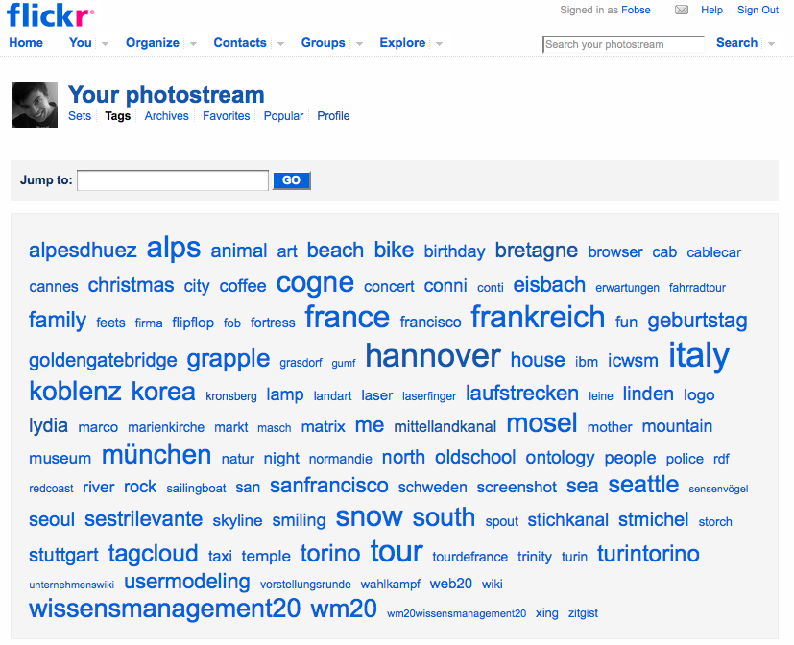
Tag-based profiles in Flickr
adaptation, ah08, brusilovsky, conference, hannover, hypermedia, L3S, nejdl, personalization,
research, web
user eelcoherder clicks on “conference”
P(r)
P(g)
tag-based
profile of
a group
(where r in g)
tag-based resource profile
P(u)
tag-based
user profile

Slide 79
Evaluating user and context modeling strategies
user & context
query
ranking algorithms
results
P(u)
P(r)
P(g)
t₁
u₉
tag
Folkrank
t₇
u₃
user clicks
on a tag
t₅
u₆
t₃
u₁
What kind of user/context modeling strategy is best for “personalized search” on Flickr?

Slide 80
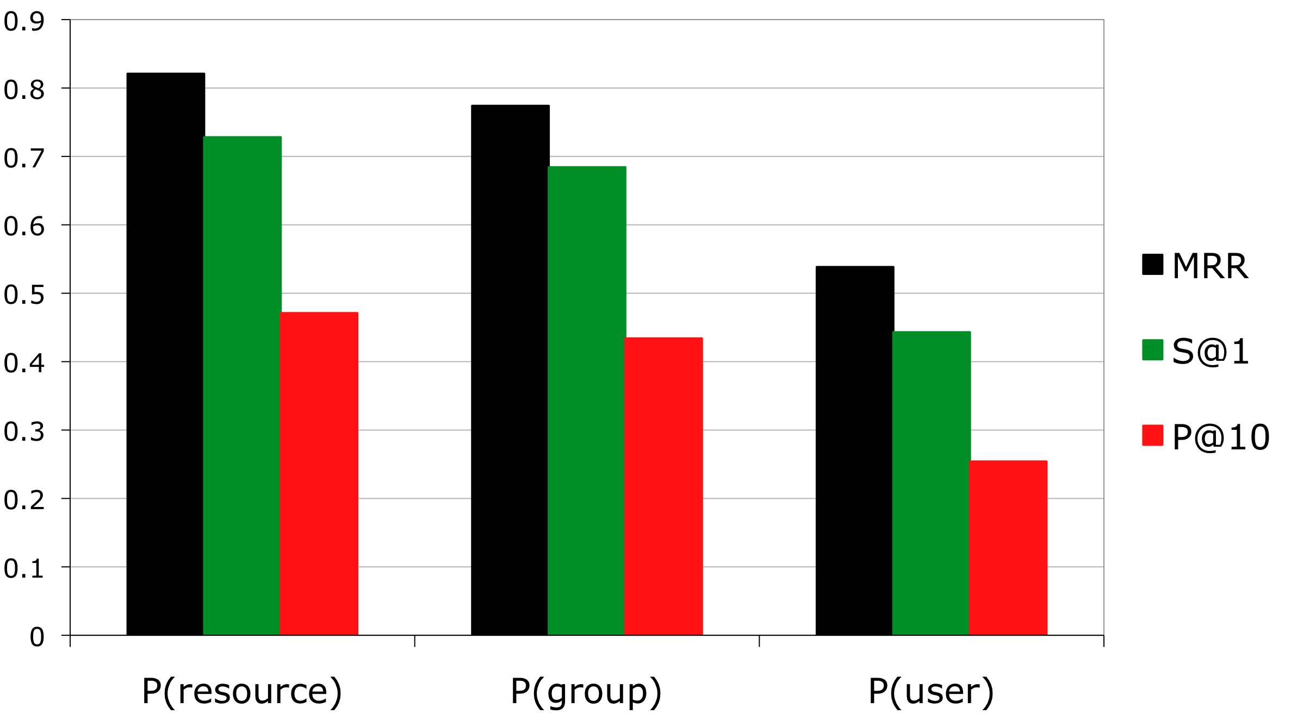
Results: User/Context Modeling
Average performance of user/context modeling strategies in ranking folksonomy entities (ground truth obtained via user study).
(Abel et al. 2010a)
Significant difference between
P(resource/group) and P(user)

Slide 81
Observation
Lightweight user/context modeling strategies perform better than long-term user modeling
tag₁
current context:
tag₂
tag₃
long-term history:
<<click>>
tag₃
tag₃
tag₁
tag₃
tag₃
tag₃
tag₃
tag₃
tag₃
tag₃
time
2009
2010
now
Good user modeling strategies adapt to adapt to the current demands (of a user/application)!

Slide 82
Tag-based Recommender Systems

Slide 83
Overview
Tag Recommendations:
Challenge:
Non-personalized: predict tags that will be assigned to a given resource
Personalized: predict tags that will be assigned to a given resource by a given user
Resource Recommendations:
Challenge:
Binary: predict resources that are considered as interesting
Predicting preference scores: predict to which degree a user will like a resource

Slide 84
Using FolkRank for Recommending Tags & Resources
Interpret recommendation problem as ranking problem
Embed personal/contextual preferences in (i) preference vector and (ii) adjacency matrix
Recommend tags/resources according to ranking
FolkRank-based rankings
(= recommendations):
users tags resources
1.
2.
FolkRank vector
preference
vector
t1
u2
r1
adjacency matrix models the folksonomy graph
t2
r2
u1
R. Jäschke, L. B. Marinho, A. Hotho, L. Schmidt-Thieme, and G. Stumme. Tag recommendations in folksonomies. PKDD 2007

Slide 85
User Modeling for Tag-based Recommendations
user & context
ranking algorithms
recommendations:
user & context modeling
tag₁
Folkrank
SocialHITS
...
t₁
Tag-based
profile
tag₂
tag₃
t₇
t₅
t₃
user visits a resource to:
tag the resource (→ tag recommendations)
explore other resources (→ resource recommendations)
Appropriate user modeling
is essential to optimize
recommendation quality.
See also: C. S. Firan, W. Nejdl, and R. Paiu. The Benefit of Using Tag-based Profiles. LA-WEB 2007

Slide 86
Evaluating Tag-based Recommendations
Leave-n-out evaluation (Geisser 1975):
remove n tag assignments
run recommender algorithms and
use removed tag assignments as ground truth
Metrics:
MRR = Mean Reciprocal Rank of first relevant item
Precision@k = fraction of relevant items within the top k
Success@k = probability that a relevant item appears within the top k
S. Geisser. The predictive sample reuse method with applications. In Journal of the American Statistical Association, pages 320–328. American Statistical Association, June 1975.

Slide 87
Related work on Tag Recommendations
Personalized:
D. Yin, Z. Xue, L. Hong, and B. D. Davison. A probabilistic model for personalized tag prediction. KDD 2010
S. Rendle, L. Balby Marinho, A. Nanopoulos, and L. Schmidt-Thieme. Learning optimal ranking with tensor factorization for tag recommendation. KDD 2009
S. Rendle and L. Schmidt-Thieme. Pairwise interaction tensor factorization for personalized tag recommendation. WSDM 2010 http://www.ismll.uni-hildesheim.de/pub/pdfs/Rendle2010-Pairwise_Interaction_Tensor_Factorization.pdf
Non-personalized:
B. Sigurbjörnsson and R. van Zwol. Flickr tag recommendation based on collective knowledge. WWW 2008
P. Heymann, D. Ramage, and H. Garcia-Molina. Social tag prediction. SIGIR 2008
R. Krestel, P. Fankhauser, and W. Nejdl. Latent Dirichlet Allocation for Tag Recommendation. RecSys 2009
Datasets:
http://www.kde.cs.uni-kassel.de/ws/dc09/dataset/
http://kmi.tugraz.at/staff/markus/datasets/

Slide 88
Resource Recommendations (Tagommenders, Sen et al. 2009)
Which task, do you think, is more difficult?
Non-personalized tag recommendations
Personalized tag recommendations
Personalized resource recommendations
S. Sen, J. Vig, and J. Riedl. Tagommenders: connecting users to items through tags. WWW 2009
http://www.grouplens.org/system/files/tagommenders_numbered.pdf

Slide 89
UMAP across Social Web Systems

Slide 90
Pitfalls of User-adaptive Systems
Hi, I’m your new
user. Give me
personalization!
System A
profile
?
System B
Hi, I have a
new-user problem!
profile
profile
How can we tackle these problems?
System C
Hi, I’m back and
I have new
interests.
profile
System D
Hi, I don’t know
that your
interests changed!
time
profile

Slide 91
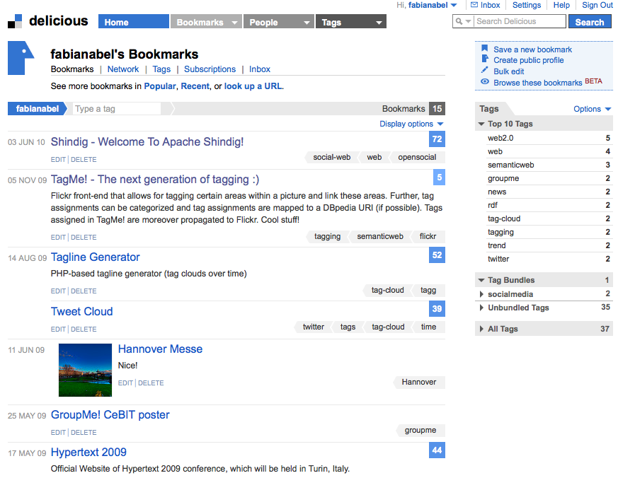
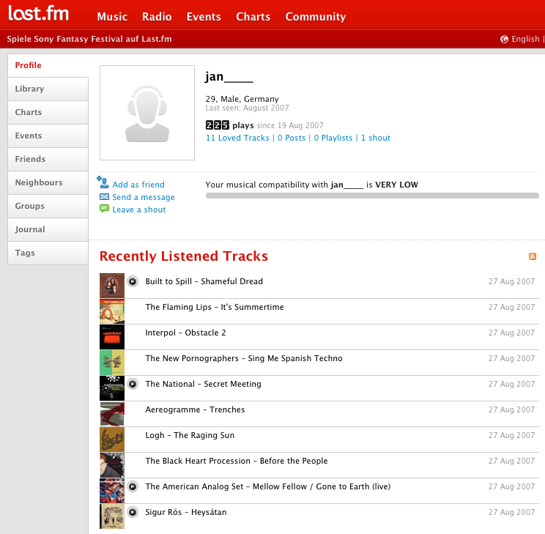
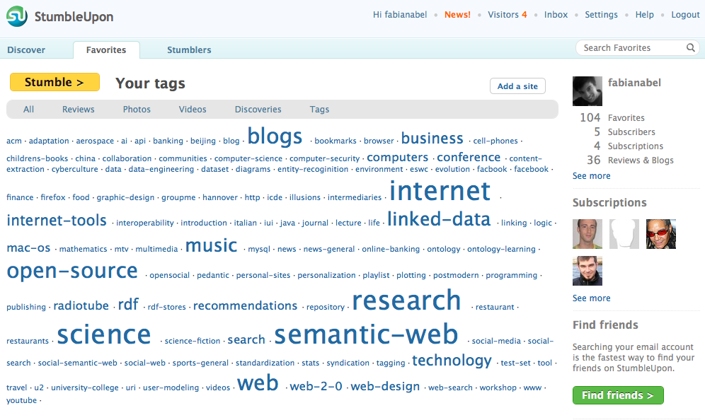
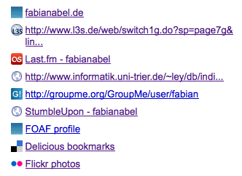
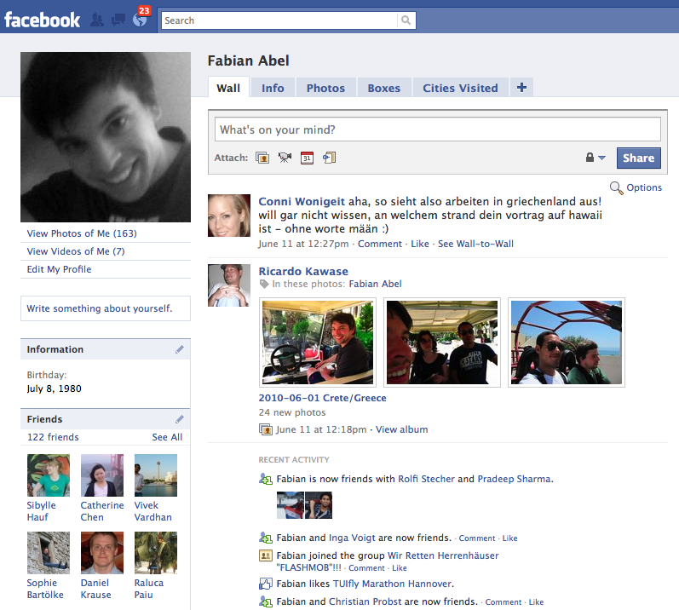
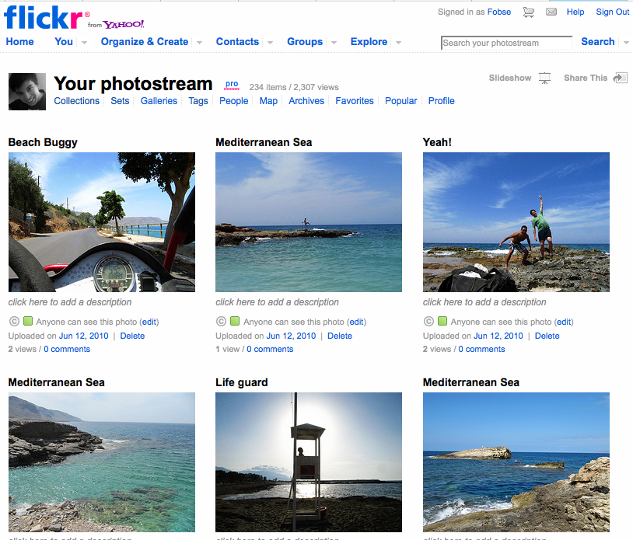
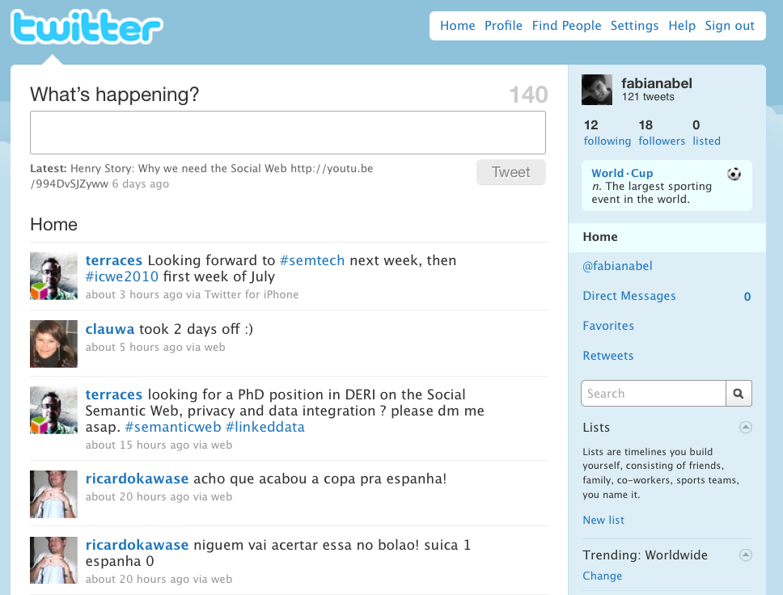
User data on the Social Web
Cross-system user modeling on the Social Web

Slide 92
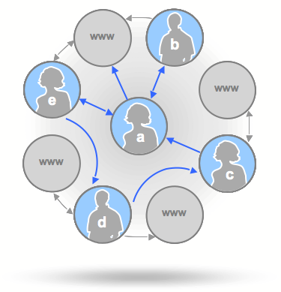
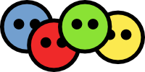
Interweaving public user data with Mypes
SocialGraph API
Google Profile URI
http://google.com/profile/XY
1. get other accounts
of user
Aggregated,
enriched profile
(e.g., in RDF or vCard)
Account Mapping
Analysis and user modeling
Blog posts:
2. aggregate
public profile
data
Social Web Aggregator
5. generate user profiles
Bookmarks:
Profile Alignment
Semantic Enhancement
3. Map profiles to
target user model
4. enrich data with
semantics
Other media:
Social networking profiles:
WordNet®
FOAF
vCard

Slide 93
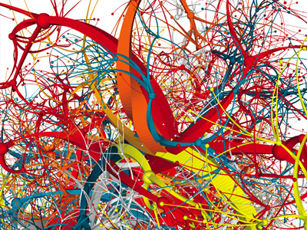
Research Questions
Main questions:
What are the characteristics of the distributed user profiles?
What are the benefits of cross-system user modeling (in particular: profile aggregation)?
How does cross-system UM impact personalization (in particular: recommending tags and Web sites)?
Data set:
1. Google profile search
2. Mypes profile aggregation
3. Filtered:
321 users with filled
tag-based profiles at:
Profile URIs
421,188
users
&
&
Please contact us if you are interested in this dataset ;-)
Delicious (bookmarking)
Flickr
(pictures)
StumbleUpon(bookmarking)

Slide 94
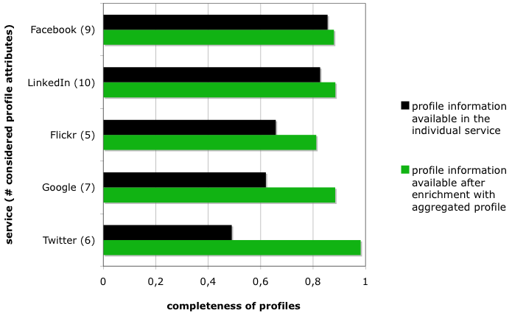
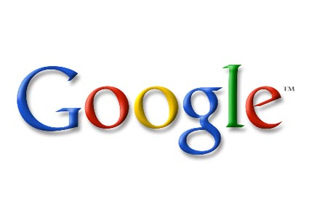
Analysis: form-based profiles
338 users with filled form-based profiles at the five different services.
1. Users fill in their public profiles at social networking services more extensively than their profiles at other services.
2. Benefits of Mypes profiles:
a. more profile facets (17 attributes; completeness: 83.3%)
b. enriches (increases profile completeness for) all service-specific profiles

Slide 95
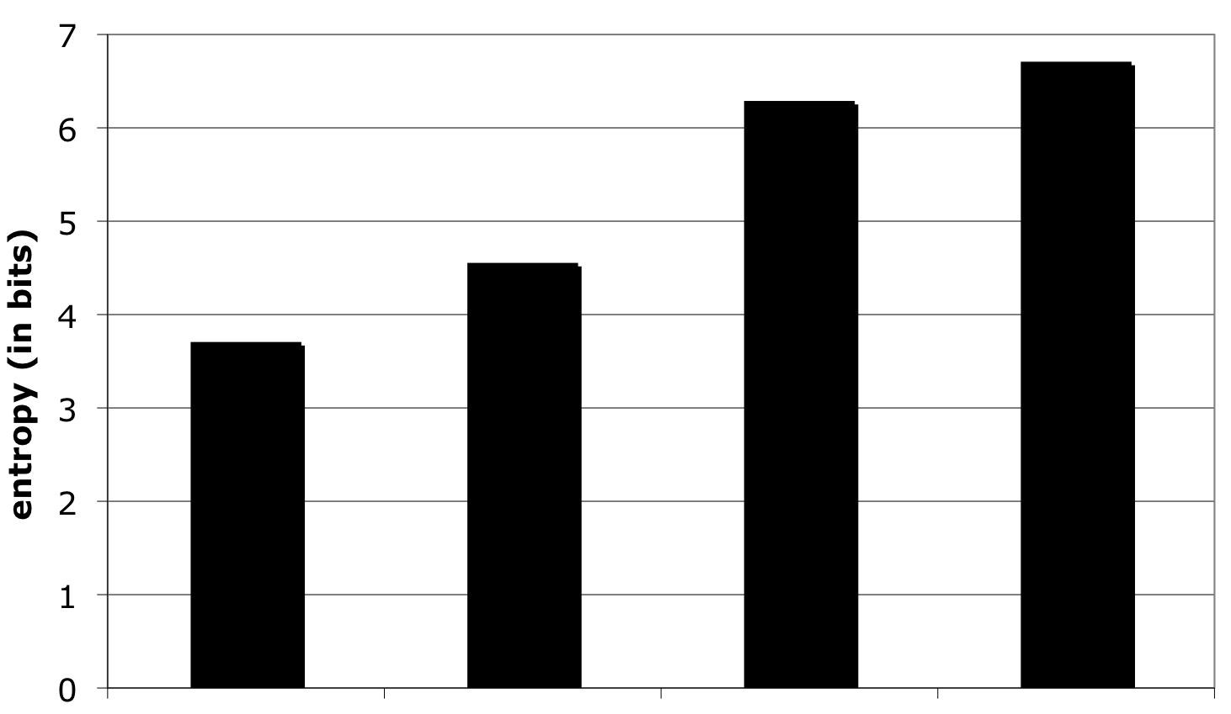
Analysis: tag-based profiles [entropy]
On average, Mypes
profiles reveal wrt
entropy significantly
more information
than the service
specific profiles.
“How much” information do the different profiles reveal about a user?
where:
- p(t) = probability that t occurs in T_{u}
- T_{u} = tags in user profile P(u)
TAS / user: 532.99 191.48 483.58 1208.06
tags / user: 90.05 90.95 192.67 349.04

Slide 96
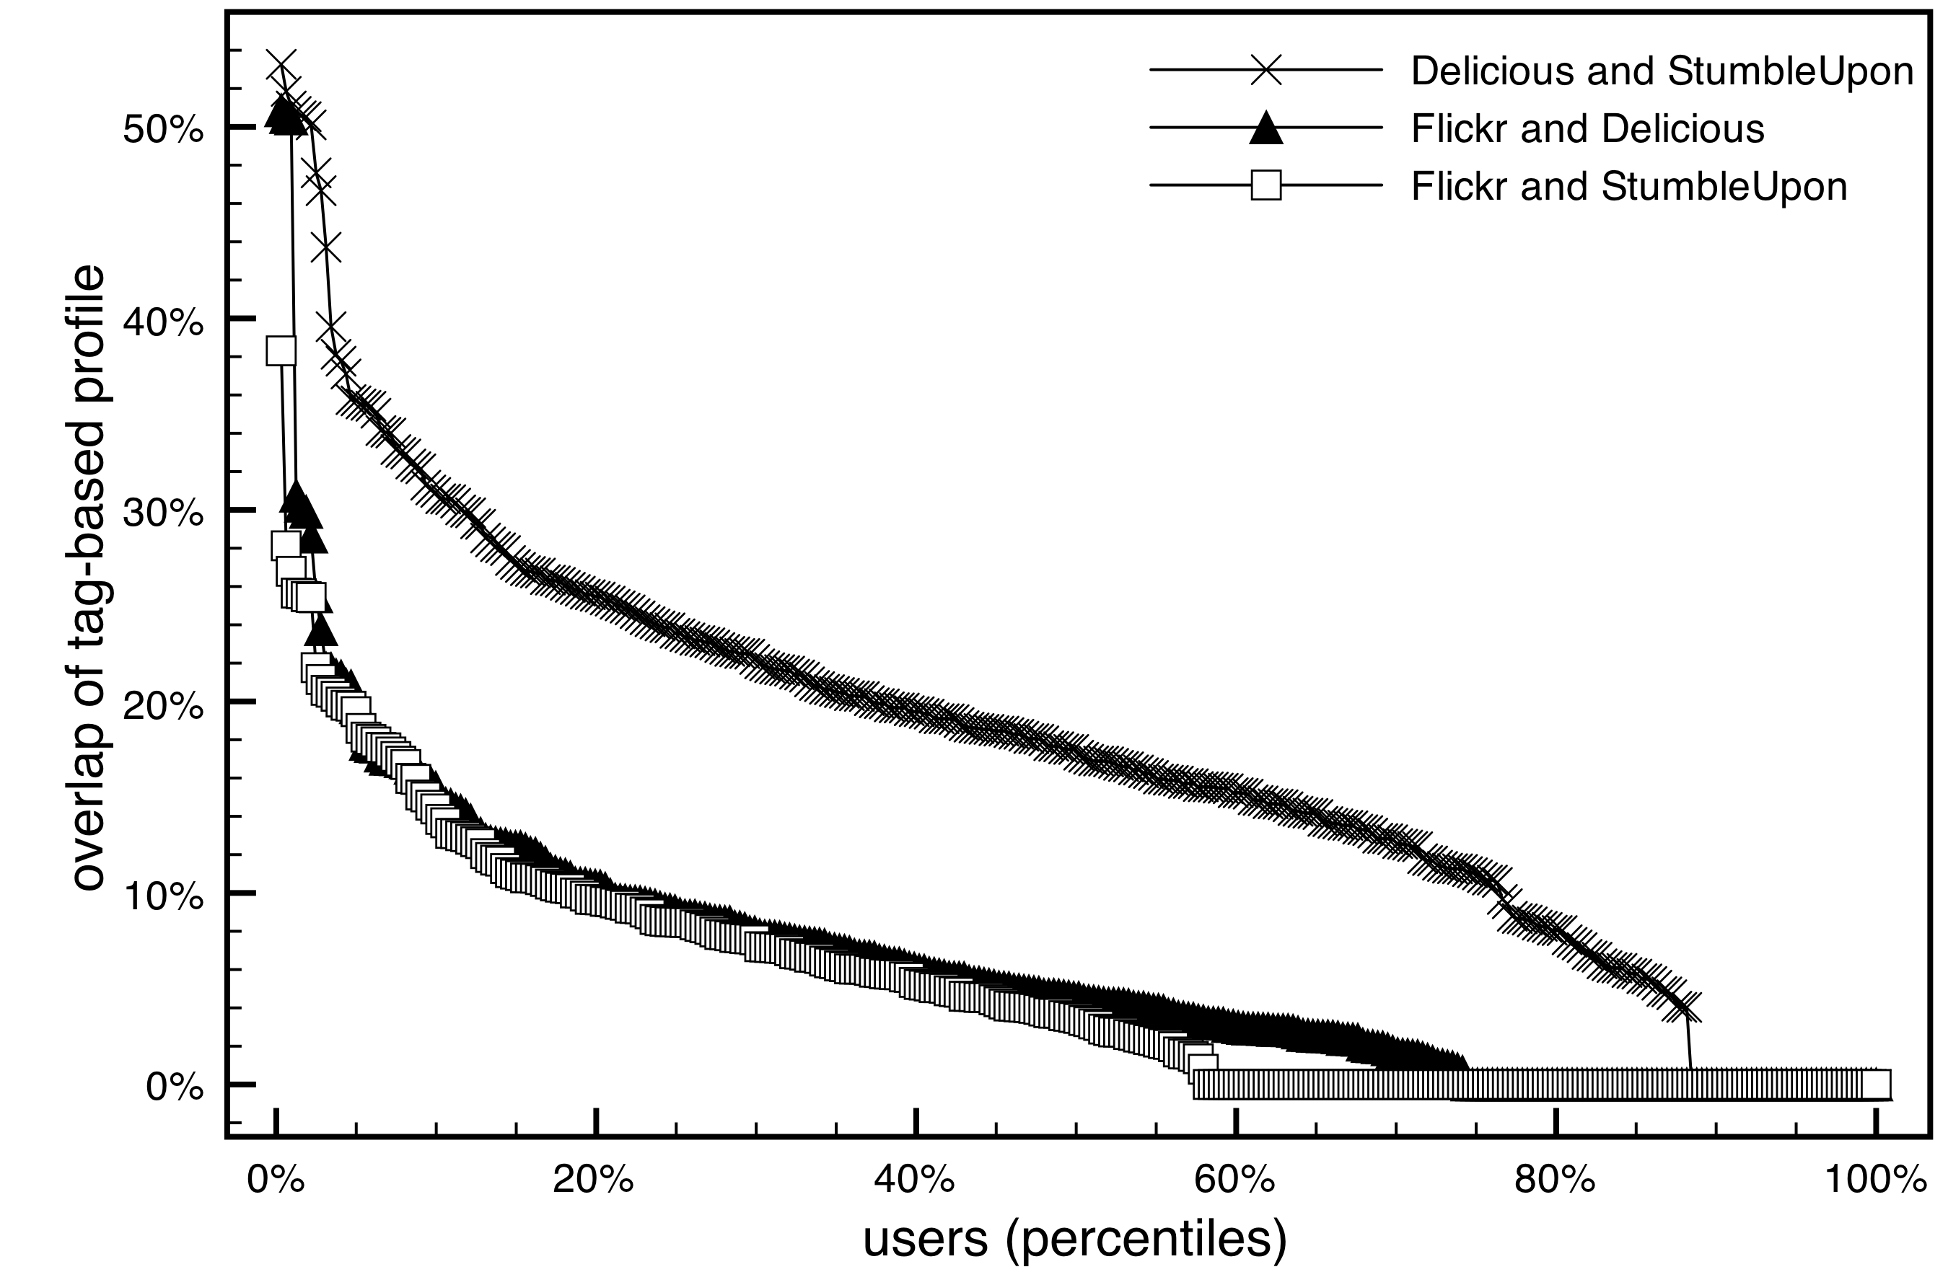
Analysis: tag-based profiles [overlap]
Overlap of tag-based profiles of the same user from different systems is small.
Overlap between Delicious and StumbleUpon is higher than for Flickr and Delicious/StumbleUpon.
Type of overlapping tags:
action, communication, group action, communication, person
location, communication, artifact

Slide 97
Evaluation: Recommending tags / Web sites
Hi, I’m your new
user. Give me
personalization!
delicious
profile
profile
?
profile
Cross-system
user modeling
tags to explore
FolkRank-based
recommender
Web sites to
bookmark
How does cross-system user modeling impact the recommendation quality (in cold-start situations)?

Slide 98
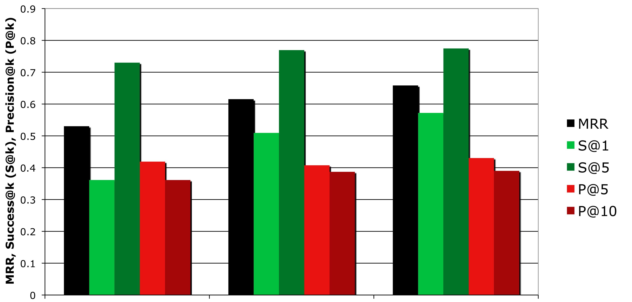
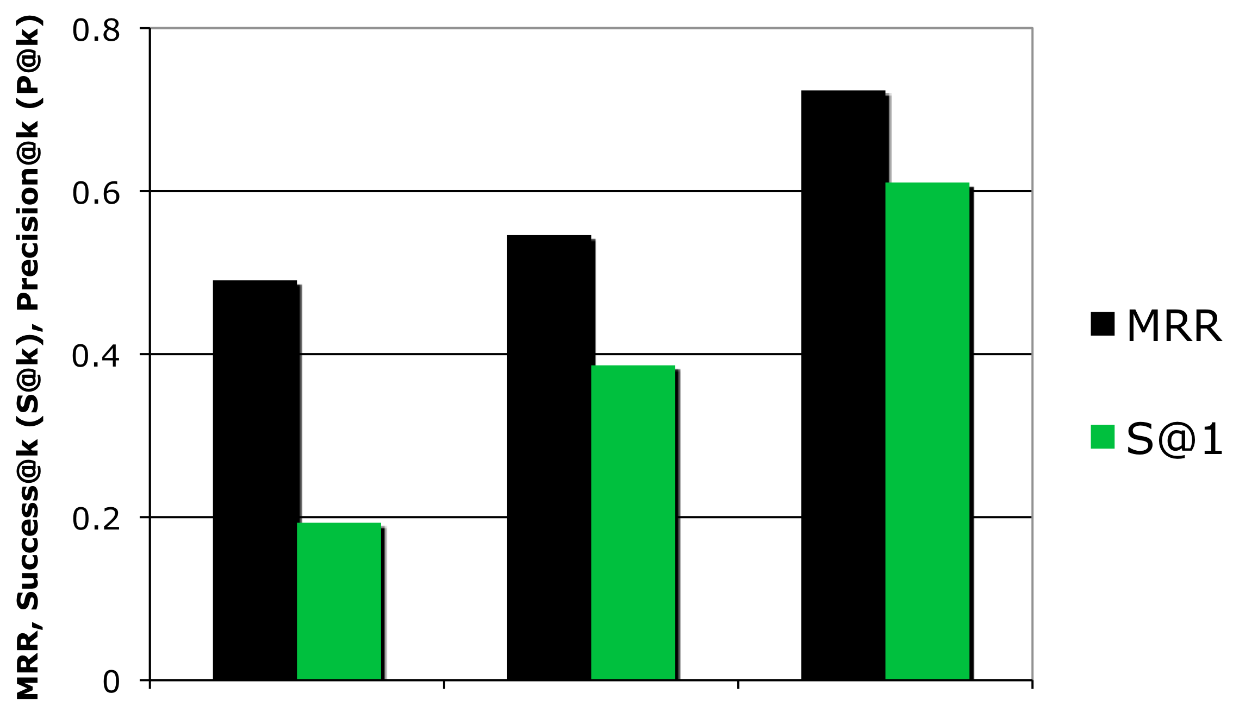
Tag recommendations (cold-start)
Average performance of user modeling strategies:
Mypes [A,B→C] improves over the baseline significantly (t-test, α=0.01)
2. The higher the overlap between
services, the better the performance:
Baseline
→
→
Baseline (popular)
[A → B]
[A,B → C]

Slide 99
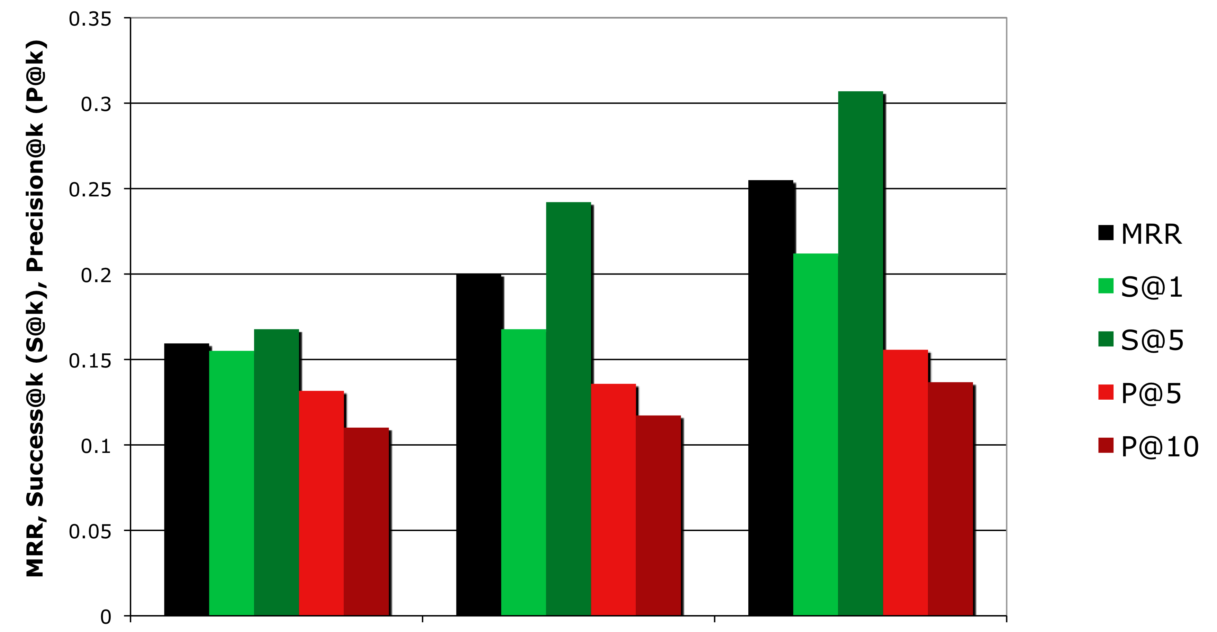
Recommending Web sites (cold-start)
Performance of user modeling strategies for recommending Web sites (ground truth = Delicious bookmarks):
Again: significant improvements when
considering external profile information
(Mypes [A,B→C]).
→
delicious
→
→
Baseline (popular)
[A → B]
[A,B → C]

Slide 100
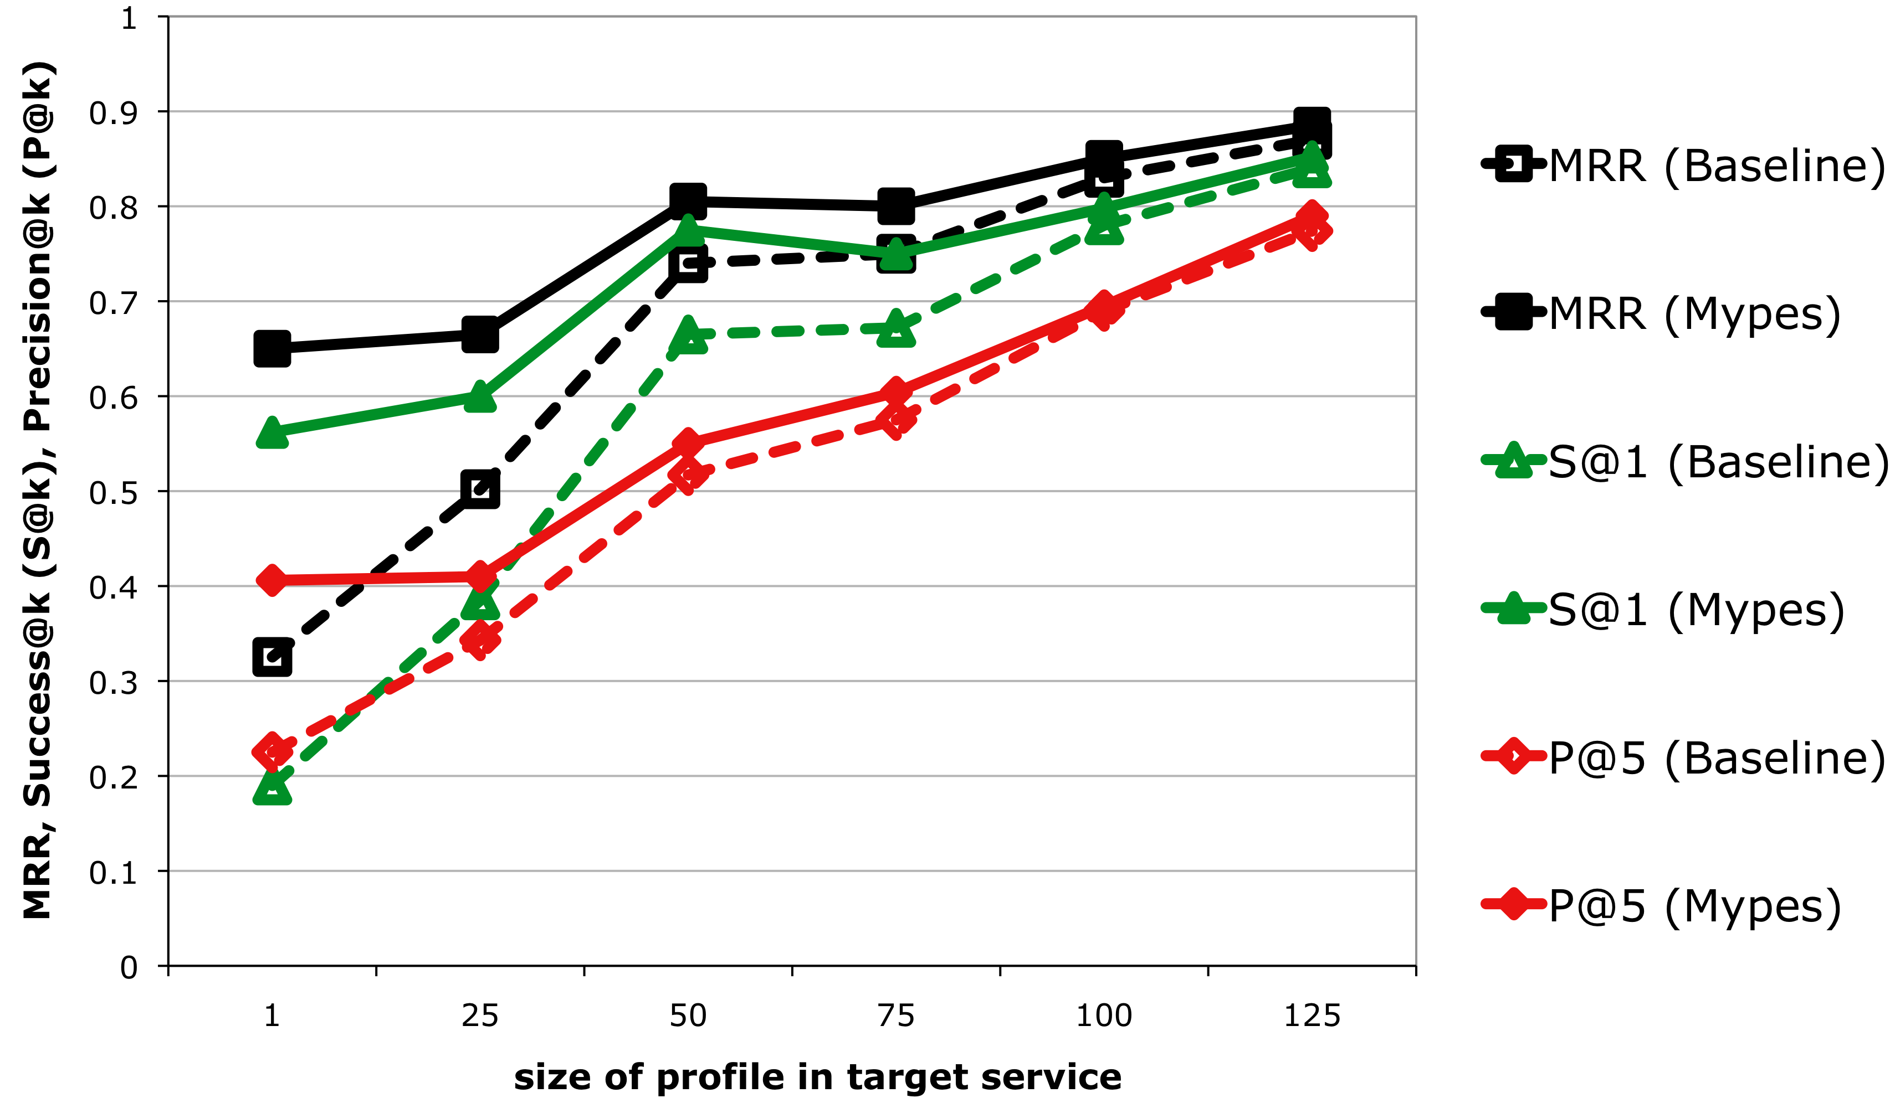
Tag Recommendations over time
Consideration of external
profile information (Mypes)
also leads to significant
improvement when the
profiles in the target service
are growing.
Baseline
(target profile)

Slide 101
Observations
Benefits of cross-system user modeling:
users reveal different facets in the different services
cross-system UM by means of profile aggregation → richer profiles (more information)
significant improvements for recommending tags and Web sites in cold-start situations
significant improvements also beyond the cold-start
Further readings: http://wis.ewi.tudelft.nl/papers/2011-umuai-cross-system-um.pdf
Further work is needed! For example:
how to translate between different tag-based profiles?
does background knowledge about the design of the tagging systems help?

Slide 102
3. Engineering UMAP on the Social Semantic Web

Slide 103
Pitfalls of User-adaptive Systems
Hi, I’m your new
user. Give me
personalization!
System A
profile
?
System B
Hi, I have a
new-user problem!
profile
profile
How can we tackle these problems?
System C
Hi, I’m back and
I have new
interests.
profile
System D
Hi, I don’t know
that your
interests changed!
time
profile

Slide 104
Towards the Personal Web

Slide 105
Interoperability for User-adaptive systems
Generic process of user-adaptive systems
(cf. Jameson 2003)
Different systems speak different languages.
System B
System C
System D
System A
name: Bob
age: 27 years
name: Bobby
Tags used:
music, funk,
jazzmusic
Tags used:
rock, mountain,
italy, hiking
Welcome message:
→ First name of the user?
Items to recommend:
→ Interested in “Rock” or “Jazz”?

Slide 106
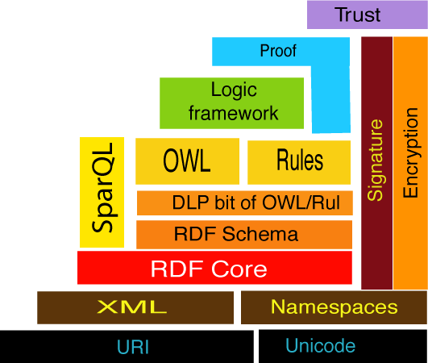
Semantic Web Principles and Standards
URI: unique identifier for concepts/resources http://www.ietf.org/rfc/rfc2396.txt
RDF: specifies the data model by means of (subject, predicate, object) statements http://www.w3.org/TR/rdf-concepts/
SPARQL: querying RDF data http://www.w3.org/TR/rdf-sparql-query/
RDF Schema / OWL: allow for the specification of ontologies/vocabularies http://www.w3.org/TR/owl2-overview/
Semantic Web protocol stack

Slide 107
Example: RDF & SPARQL
System A
Welcome message:
→ First name of the user?
Items to recommend:
→ Interested in “Rock” or “Jazz”?
RDF representation:
SPARQL representation:
Name and interests:
System C
<http://bob.myopenid.com>
a foaf:Person;
foaf:interest dbpedia:Music;
foaf:interest dbpedia:Funk;
foaf:interest dbpedia:Jazz .
SELECT ?name ?interest
WHERE {
<http://bob.myopenid.com>
foaf:name ?name ;
foaf:interest ?interest }.
name: Bobby
Tags used:
music, funk,
jazzmusic
System D
<http://bob.myopenid.com>
a foaf:Person;
foaf:interest
dbpedia:Rock_(geology);
foaf:interest dbpedia:Hiking;
...
Interested in rock music?
SELECT ?name ?interest
WHERE {
<http://bob.myopenid.com>
foaf:interest
dbpedia:Rock_music }.
Tags used:
rock, mountain,
italy, hiking
different concepts

Slide 108
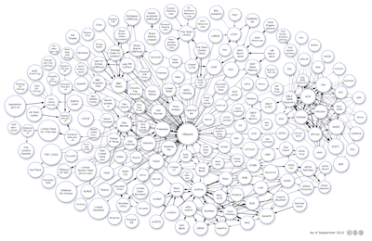
Linked Data http://linkeddata.org/
Linked Data principles (Berners-Lee 2007):
Use URIs as names for things
Use HTTP URIs so that people can look up those names
When someone looks up a URI, provide useful information, using the standards (e.g. RDF/XML)
Include links to other URIs so that they can discover more things.
Linked Social Data: do Semantic Web standards and Linked Data principles solve problems caused by heterogeneous profile information?
Our view: Semantic Web provides useful and necessary instruments! However, in addition we still need to do much science and engineering to realize a Personal Web.
T. Berners-Lee. Linked Data - design issues. W3C, May 2007. http://www.w3.org/DesignIssues/LinkedData.html

Slide 109
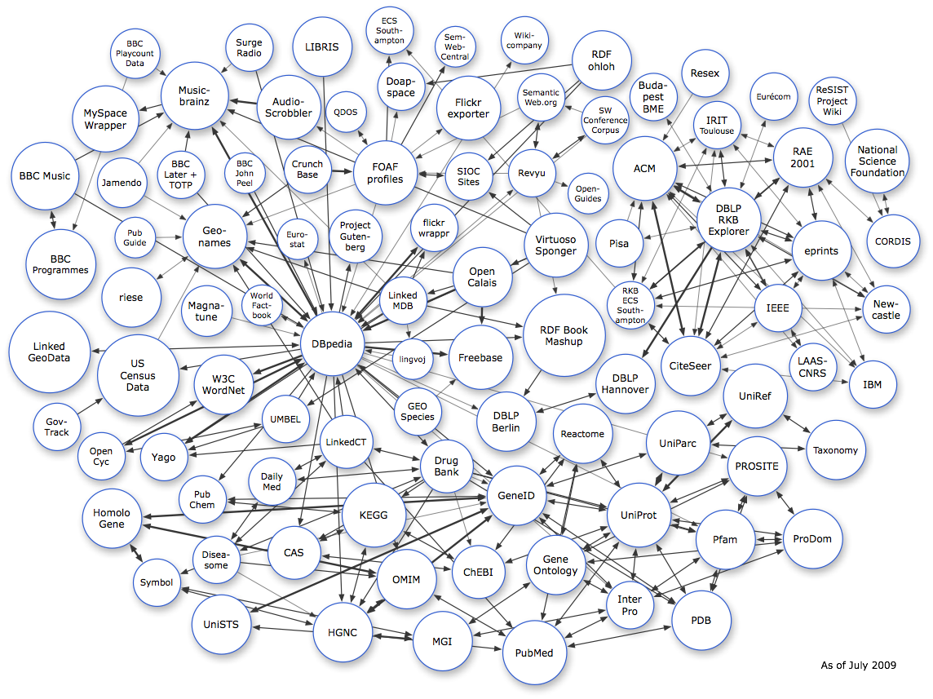
Science and Engineering for the Personal Web
Personalization
Analysis and
User Modeling
Semantic Enrichment, Linkage, Alignment
Semantic Web
Web
user/usage data
Social Networking
Social Tagging
Microblogging
Social Web

Slide 110
Various applications & domains
domains: news social media cultural heritage public data e-learning
Personalized
Recommendations
Personalized Search
Adaptive Systems
Analysis and
User Modeling
Semantic Enrichment, Linkage, Alignment
user/usage data
Social Web

Slide 111
What we need
User modeling infrastructure:
monitor users’ Social Web activities
infer semantics from user data
provide user modeling functionality as a customizable service
System
(aiming for personalization)
User Modeling infrastructure
user
personalization
profile

Slide 112
U-Sem: Towards a User Modeling Infrastructure
SPARQL &
U-Sem query extensions
Query Endpoints (SPARQL)
U-Sem Application Logic
(Authentication, Access Control, Plug-in management)
Storage Endpoints (RDF)
Orchestration Logic
user profiles (FOAF,
Weighted Interests)
domain knowledge
observations
user characteristics
RDF Gears
…
Semantic Enrichment, Linkage, and Alignment
Analysis and
User Modeling
data aggregation
entity extraction
profile generation
rule-based reasoning
clients
ontology alignment
entity identification
conflict resolution
temporal reasoning
topic detection
…
knowledge discovery
…
U-Sem Data Repositories
Other Repositories
Web

Slide 113
Semantic Enrichment
Orchestration Logic
Semantic Enrichment, Linkage, and Alignment
Analysis and
User Modeling
Challenges: Enriching the semantics of user/usage data:
Topic detection (e.g. topic of a Web site that was bookmarked by a user, topic of a Twitter message, etc.)
(Named) entity extraction (e.g. people, products or organizations, to which a user refers to in hi blog posts)
Infer sentiment from user data
Useful services:
OpenCalais: enriches given textual content with semantic metadata (e.g. topic detection, (named) entity extraction) http://www.opencalais.com/
DBpedia Spotlight: detects (and disambiguates) DBpedia resources in textual content (named entity recognition) http://dbpedia.org/spotlight
Other NLP tools:
GATE, WEKA, LingPipe, etc.

Slide 114
Semantic Enrichment Tagging example
Orchestration Logic
Semantic Enrichment, Linkage, and Alignment
Analysis and
User Modeling
armstrong
fabian
http://example.org/23.png
Representation of tag assignment via Tag Ontology:
<http://example.org/tas/1>
a tag:RestrictedTagging;
tag:taggedResource <http://example.org/23.png>;
foaf:maker <http://fabianabel.myopenid.com>;
tag:associatedTag <http://example.org/tag/armstrong>
.
& MOAT extension
moat:tagMeaning <http://dbpedia.org/resource/Louis_Armstrong>
Tag ontology: http://www.holygoat.co.uk/projects/tags/
MOAT: http://moat-project.org/

Slide 115
Linkage
Orchestration Logic
Challenges:
Linking online accounts of users
Linking different (user) data fragments to better understand the demands of a user
Useful protocols/services:
OpenID: authentication protocol, unique URI that identifies a user http://openid.net/
OAuth: authorization protocol (authorize applications to access data) http://oauth.net
Social Graph API: service that allows for querying the social graph of a user (publicly available social networking data) http://code.google.com/apis/socialgraph/
Mypes: aggregating public user data http://mypes.groupme.org/
Methods for linking user accounts:
Based on user characteristics → form-based profile information, e.g. (Carmagnola & Cena 2009))
Based on tagging behavior → tag-based profiles, e.g. (Iofciu et al. 2011)
Semantic Enrichment, Linkage, and Alignment
Analysis and
User Modeling
Further work is needed! For example:
how to ensure trust and privacy in distributed Social Web settings?
Stefan Decker: “in addition to robots.txt we will need some sort of aggregations.rdf” (ISWC 2007)
F. Carmagnola and F. Cena. User identification for cross-system personalisation. Information Sciences: an International Journal, 179(1-2):16–32, 2009.
T. Iofciu, P. Fankhauser, F. Abel, K. Bischoff. Identifying Users Across Social Tagging Systems. ICWSM 2011

Slide 116
Alignment
Orchestration Logic
Semantic Enrichment, Linkage, and Alignment
Analysis and
User Modeling
Challenges:
Ontology alignment: transformations between heterogeneous schemata
Aligning user data that originates from different sources (different systems may imply different language models, e.g.: how to fusion a user’s Twitter stream with her classical Blog?)
Useful tools:
SILK: Link Discovery Framework for the Web of Data http://www4.wiwiss.fu-berlin.de/bizer/silk/
Alignment API: Java library for discovering, storing and sharing alignments
http://alignapi.gforge.inria.fr/

Slide 117
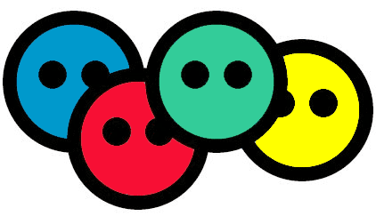
Analysis and User Modeling
Orchestration Logic
Semantic Enrichment, Linkage, and Alignment
Analysis and
User Modeling
Challenges:
Analysis: understanding user data
User Modeling: transforming user data into structures that support applications
Useful Vocabularies:
FOAF: Friend-Of-A-Friend vocabulary for representing people, organizations and documents http://xmlns.com/foaf/spec/
Weighted Interest Vocabulary: FOAF extension to express weighted interests http://purl.org/ontology/wi/core#
Overview on Linked Data Vocabularies http://labs.mondeca.com/dataset/lov/

Slide 118
Analysis and User Modeling
Example: Representing Interests
Orchestration Logic
Semantic Enrichment, Linkage, and Alignment
Analysis and
User Modeling
Via Weighted Interest vocabulary:
user
<http://fabianabel.myopenid.com>
a foaf:Person;
wi:preference [
a wi:WeightedInterest;
wi:topic <http://dbpedia.org/resource/Louis_Armstrong>
wo:weight [
a wo:Weight;
wo:weight_value 0.78;
wo:scale ex:Ascale
]
] .
topic of interest
weight: to what degree is the user interested?
how to interpret the weight?

Slide 119
Orchestration Logic
Orchestration Logic
Semantic Enrichment, Linkage, and Alignment
Analysis and
User Modeling
Challenge:
Creating user modeling workflows by orchestrating semantic enrichment, linkage, alignment, analysis and modeling plug-ins
Useful tools:
Semantic Web Pipes: engine and graphical user interface for mashing up Semantic Web data http://pipes.deri.org/
RDF Gears: extends Semantic Web pipes https://bitbucket.org/feliksik/rdfgears/
data aggregation
entity identification
conflict resolution
entity extraction
profile reasoning
profile generation

Slide 120
Exploiting Microblogging Activities for Personalizing the Social Web

Slide 121
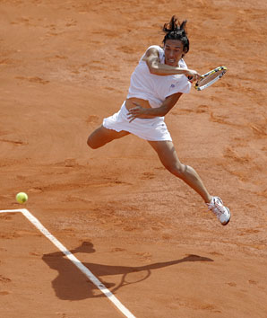
Analyzing temporal dynamics of Twitter-based Profiles for Personalized Recommendations (in time)
Recommendations in time:
Interests:
Tennis
Football
Francesca Schiavone is great!
Thirty in women's
tennis is primordially
old, an age when
agility and desire
recedes as the
next wave of younger/faster/stronger players encroaches. It's uncommon for any athlete to have a breakthrough season at 30, but it's exceedingly…
Personalized news recommendations
Ajax gives
De Jong
a break
Ajax manager Frank de
Boer announced that…
interest
I like this http://bit.ly/4Gfd2
Analysis and
User Modeling
interest
time
time
Semantic Enrichment, Linkage, Alignment
topic:Tennis
Nice, thank you!
dbpedia:Schiavone
tweets
event:FrenchOpen
oc:Sports

Slide 122
Challenge: Understanding the semantics of tweets
Tweets are limited to 140 characters → semantics are hard to infer
Tweets may refer to external Web resources that help (e.g. ~85% of the tweets are related to news (Kwak et al. 2010))
I like this http://bit.ly/4Gfd2
#fopen winner Francesca best athlete of the year!
SI Sportsman of the year:
Surprise French Open champ
Francesca Schiavone
Thirty in women's tennis is primordially old, an age when agility and desire recedes as
Francesca Schiavone won #sport #tennis
tweets
news article

Slide 123
Linking to external Web resources
URL-based
I like this
http://bit.ly/eiU33c
URL
SI Sportsman of the year:
Surprise French Open champ
Francesca Schiavone
Thirty in women's tennis is primordially old…
Content-based
Francesca Schiavone is sportsman of the year #sport #tennis
Francesca Schiavone won #sport #tennis
Hashtag-based
Petkovic & Goerges leading German tennis revival
there are signs that German tennis is…

Slide 124
Linking to external Web resources (cont.)
publish date:
Jan 14, 2011
SI Sportsman of the year:
Surprise French Open champ Francesca Schiavone
Thirty in women's tennis is primordially old…
Entity-based
Francesca Schiavone won #sport #tennis
publish date:
Nov 20, 2010
publish date:
Jan 15, 2011
temporal constraint
Entity-based
Olympic champion and world number nine Elena Dementieva announced her retirement
The 29-year-old Russian delivered the shock news after losing to Francesca Schiavone in the group stages of the season-ending tournamen …
Old news ☹
(Abel et al. 2011b) Fabian Abel, Qi Gao, Geert-Jan Houben, Ke Tao. Semantic Enrichment of Twitter Posts for User Profile Construction on the Social Web. ESWC 2011
Notes:
Change label

Slide 125
Research Questions
How do topics evolve over time?
How do Twitter-based user profiles evolve over time?
Can we exploit Twitter-based profiles for personalizing users’ Social Web experience?
Personalized recommendations
in time:
interest
topic A
?
?
topic B
time
time

Slide 126
Dataset
more than:
20,000
Twitter users
4
months
30,000,000
tweets
Egyptian revolution
Jan 25
time
Nov 15
Dec 15
Jan 15
Feb 15

Slide 127
1. How do topics evolve over time?
What are topics? How can we represent a topic?

Slide 128
Representing a topic: via entities (and hashtags)
Mubarak
Egypt
Topic = Egyptian revolution
#jan25
Cairo
#tahrir

Slide 129
1. How do topics evolve over time?
day of revolt
Friday of rage
Friday of
departure
shutdown of
Internet
battle of the
camel
time
Egyptian revolution
Jan 25
Jan 28
Feb 2
Feb 11

Slide 130
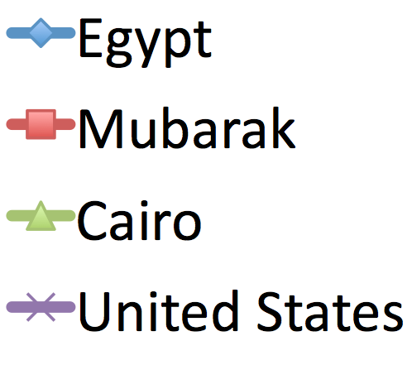
Popularity of related entities over time
Some entities are continuously relevant for a topic (long lifespan for the topic).
Jan 20
Jan 24
Jan 28
Feb 1
Feb 5
Feb 9
Feb 13
Feb 17
Feb 21

Slide 131
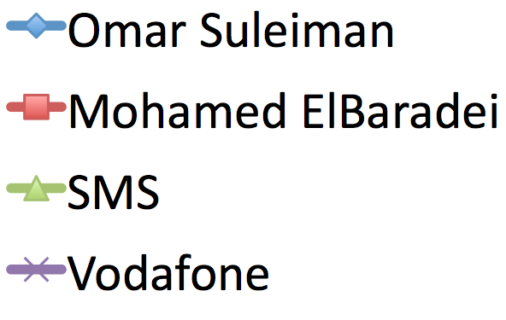
Popularity of related entities over time (cont.)
Omar Suleiman sworn as vice president
Mohamed ElBaradei joins the protests
SMS services suspended
Vodafone network hijacked by Egypt
Some entities have a rather short lifespan for the topic.
Jan 20
Jan 24
Jan 28
Feb 1
Feb 5
Feb 9
Feb 13
Feb 17
Feb 21

Slide 132
1. How do topics evolve over time? → Observations
Importance of entities that represent a topic varies over time
(long-term vs. short-term lifespan of entities)
Representation of a topic (topic profile) depends on the time when it is requested

Slide 133
2. How do the interests of individual users into a topic change over time?
(When) is Bob interested into the topic?
interest
topic A
?
topic B
time

Slide 134
When do users become interested?
Friday of rage
day of revolt
“Followers”
Early adopters
Friday of departure
If a user becomes interested into the topic then she become interested within a few days

Slide 135
Users’ interests over time
Some users are continuously interested into a topic
(long-term adopters).
user A
user B
user C
Jan 20
Jan 25
Jan 30
Feb 4
Feb 9
Feb 14
Feb 19
Feb 24
Mar 1
Mar 6

Slide 136
Users’ interests over time (cont.)
Other users are interested into a topic only for a short period in time
(short-term adopters).
user D
user E
user F
Jan 20
Jan 25
Jan 30
Feb 4
Feb 9
Feb 14
Feb 19
Feb 24
Mar 1
Mar 6
Notes:
Usually this interest

Slide 137
Users’ interests over time (cont.)
σ
short-term adopters
user D
#tweets
time
lifespan of interest
long-term adopters
σ
user A
#tweets
users
time
Notes:
Usually this interest

Slide 138
2. How do the interests of individual users into a topic change over time? → Observations
Most users, who are interested into the topic, become interested within a few days
Lifespan of users’ interest:
Long-term adopters
Short-term adopters
High overlap between early adopters and long-term adopters
Notes:
Long-term adopters: continuously interested
Short-term adopters: interested only for a short period in time (and influenced by “global trends”)

Slide 139
3. Can we exploit Twitter-based profiles for personalizing users’ Social Web experience?
Personalized recommendations
in time:
interest
topic A
?
?
topic B
time
time

Slide 140
Twitter-based user profiles
Profile type:
i) Hashtag-based vs. ii) Entity-based
User Profile:
References of user u to
concepts A and B:
P(u,t₁)= ?
Weighting schemes:
“term frequency”: use entire user history)
# references to A/B
A
B
ii) time-sensitive: weigh concepts a user is “currently” interested in stronger than others
time
t₁

Slide 141
Twitter-based Profiles for Personalization
Task: Recommending Web sites (= tweets with URLs)
Recommender algorithm: cosine similarity between profile and tweets
Ground truth: re-tweets of users
Candidate items: URLs posted on day X
Evaluation period: 12 days (Jan 20th – Jan 30th 2011)
Recommendations = ?
P(u,t₁)= ?
time
day X

Slide 142
Impact of time-sensitive weighting function
Entity-based
(time-sensitive)
Time-sensitive profiles improve recommendation quality
Hashtag-based
(time-sensitive)
Entity-based
Hashtag-based

Slide 143
Recommendation quality varies for different types of users
Hashtag-based user modeling performs best
Long-term adopters
Short-term adopters
Entity-based user modeling performs best

Slide 144
Impact of profile size on recommendation quality
MRR
MRR
profile size & performance
profile size
profile size
Hashtag-based profiles:
The bigger the profile the higher the recommendation quality (MRR).
Entity-based profiles:
More robust against “sparse” profiles.

Slide 145
Summary of Observations
Topics on Twitter:
Importance of entities for a topic varies over time (long-term vs. short-term entities)
User interests over time:
Majority of users becomes quickly (few days) interested in a topic
Long-term adopters vs. Short-term adopters
Twitter-based profiles for personalization:
Time-sensitive user modeling seems to improve recommendation quality
Selection of user modeling strategy should take the “type of user into account”. For example:
Long-term adopters: hashtag-based
Short-term adopters: entity-based
Further details: http://wis.ewi.tudelft.nl/tweetum/

Slide 146
Conclusion

Slide 147
Conclusion
For an optimal delivery of relevant information, we have to ‘understand’ the information AND the user. There is a still lot to be gained from better user modeling.
Good user modeling requires good timing: understanding the current (user/application) demands is essential for successful user modeling and personalization.
The science of user modeling has to balance the engineering of adaptive information delivery.
We need to stick to standards (→ Semantic Web) and base new solutions on existing ones in order to quickly engineer a Personal Web.

Slide 148
Future Directions
Enriching user models with Linked Open Data
Knowledge extraction from Social Web activities of the users
Cross-domain user model integration and user model alignment
User identification (e.g. based on certain Social Web activities of a user)
User property representation (vocabularies)
User perception of open user modeling
Scrutability
Trust
Privacy

Slide 149
Thank You!
Contact:
Fabian Abel and Geert-Jan Houben
Twitter: @persweb
http://persweb.org
Further pointers: http://wis.ewi.tudelft.nl/icwe2011/tutorial/

Slide 150
References
Complete list of references: http://wis.ewi.tudelft.nl/icwe2011/tutorial/
(Abel et al. 2011) F. Abel, E. Herder, G.-J. Houben, N. Henze, D. Krause. Cross-system User Modeling and Personalization on the Social Web. In P. Brusilovski, D. Chin (eds.): User Modeling and User-Adapted Interaction (UMUAI), Special Issue on Personalization in Social Web Systems, 2011 http://wis.ewi.tudelft.nl/papers/2011-umuai-cross-system-um.pdf
(Abel et al. 2010) F. Abel, M. Baldoni, C. Baroglio, N. Henze, R. Kawase, D. Krause, and V. Patti. Leveraging search and content exploration by exploiting context in folksonomy systems. In D. Cunliffe and D. Tudhope, editors, New Review of Hypermedia and Multimedia: Web Science, volume 16, pages 33–70. Taylor & Francis, April 2010.
(Abel et al. 2009) F. Abel, N. Henze, D. Krause, and M. Kriesell. On the effect of group structures on ranking strategies in folksonomies. In R. Baeza-Yates and I. King, editors, Weaving Services and People on the World Wide Web, pages 275–300. Springer, July 2009. http://groupme.org/papers/chapter-groupme-ranking-in-folksonomies.pdf
(Bao et al. 2007) S. Bao, G. Xue, X. Wu, Y. Yu, B. Fei, and Z. Su. Optimizing Web Search using Social Annotations. In Proc. of 16th Int. World Wide Web Conference (WWW ’07), pages 501–510. ACM Press, 2007.
(Brusilovsky 2001) P. Brusilovsky. Adaptive hypermedia. In User Modeling and User-Adapted Interaction (UMUAI), 11(1/2):87-110, 2001.
(De Bra et al. 1999) P. De Bra, G.J. Houben, H. Wu. AHAM: A Dexter-based reference model for adaptive hypermedia. In Proc. ACM Hypertext, pages 147-156. ACM Press, 1999.
(Hotho et al. 2006) A. Hotho, R. Jäschke, C. Schmitz, and G. Stumme. Information retrieval in folksonomies: Search and ranking. In Proc. ESWC, volume 4011 of LNCS, pages 411–426, Budva, Montenegro, 2006. Springer. http://www.kde.cs.uni-kassel.de/pub/pdf/hotho2006information.pdf
(Jameson 2003) A. Jameson. Adaptive interfaces and agents. The HCI handbook: fundamentals, evolving technologies and emerging applications, pages 305–330, 2003.
(Jeh and Widom 2002) G. Jeh and J. Widom. SimRank: A Measure of Structural-Context Similarity. In Proceedings of KDD ’02, pages 538–543, New York, NY, USA, 2002. ACM.
(Kleinberg 1999) J. M. Kleinberg. Authoritative sources in a hyperlinked environment. Journal of the ACM, 46(5):604–632, 1999.
(Mayfield 2006) R. Mayfield. Power-law of participation. April 2006. http://ross.typepad.com/blog/2006/04/power_law_of_pa.html
(Vander Wal 2005) T. Vander Wal. Explaining and showing broad and narrow folksonomies. 2005 http://www.vanderwal.net/random/entrysel.php?blog=1635
(Wu et al. 2006) H. Wu, M. Zubair, and K. Maly. Harvesting social knowledge from folksonomies. In Proceedings of the seventeenth conference on Hypertext and hypermedia (HYPERTEXT ’06), pages 111–114, New York, NY, USA, 2006. ACM Press.

